Slide 1
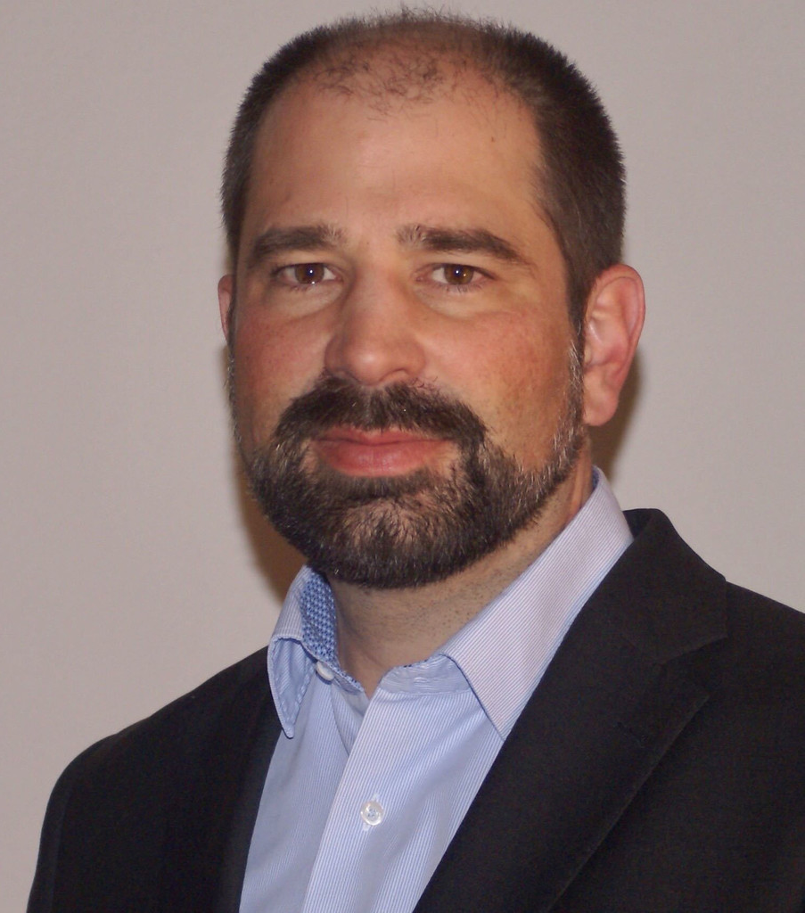
Smart Energy - Hydrogen
Dr. Luzi Valär
Vice President R&D
Burckhardt Compression AG
Luzi.Valaer@burckhardtcompression.com

Slide 2
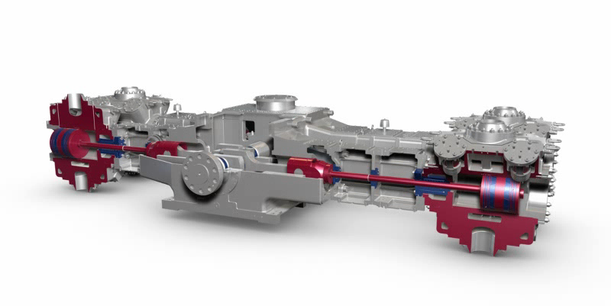
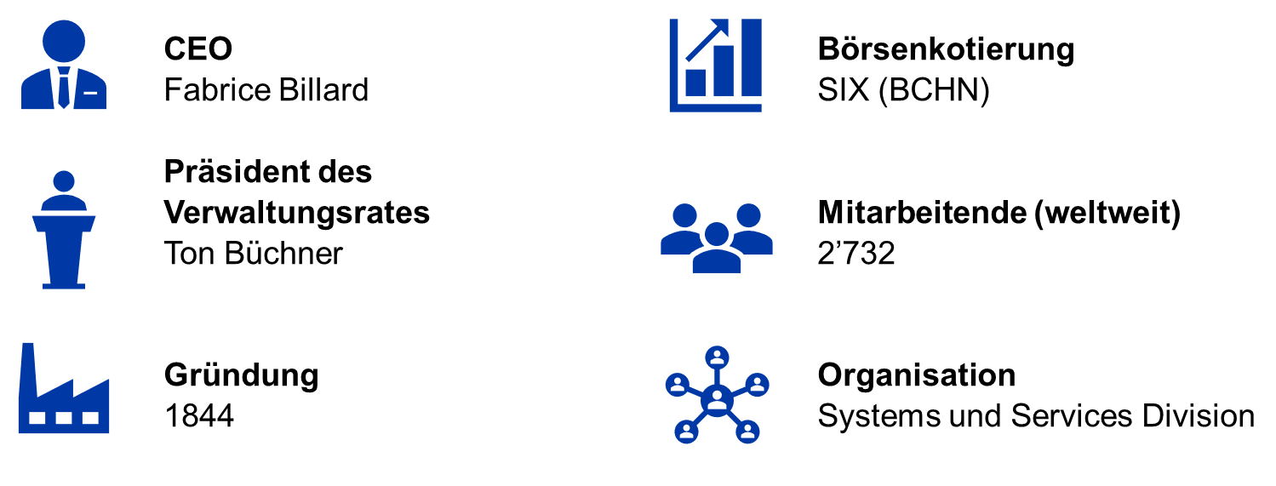
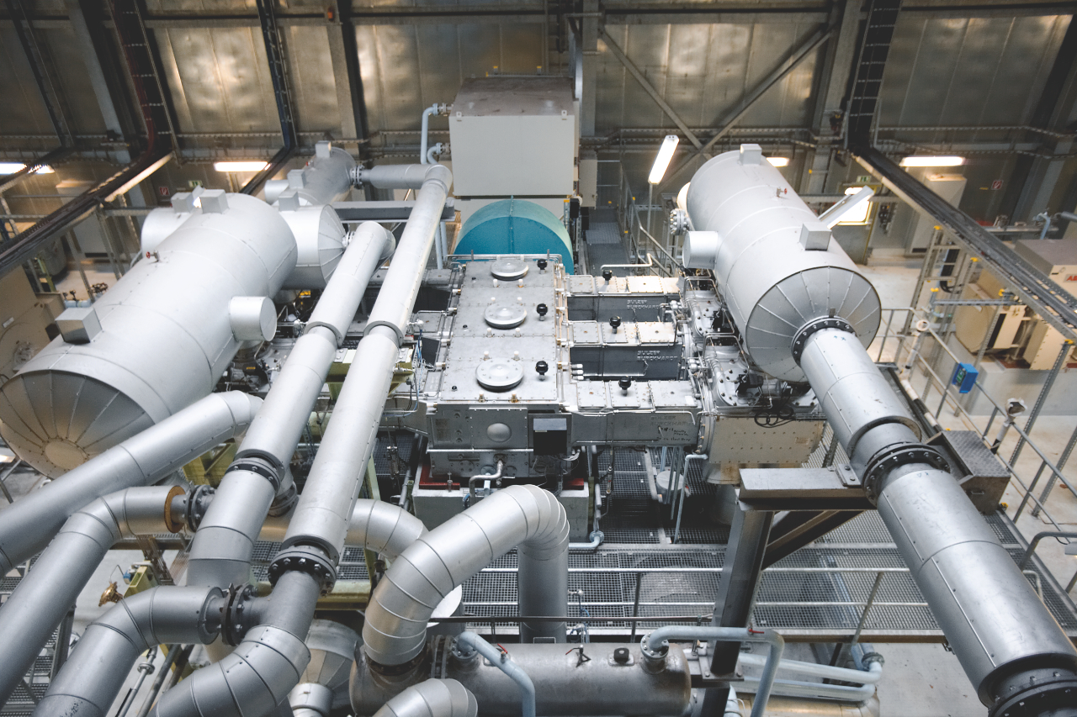

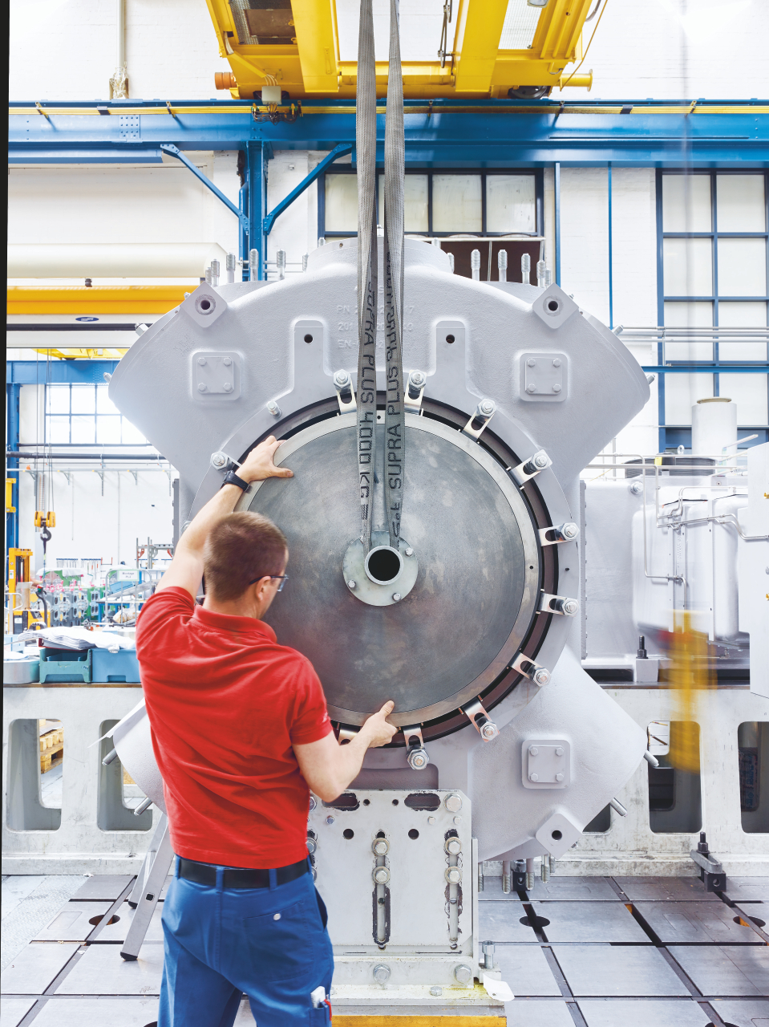
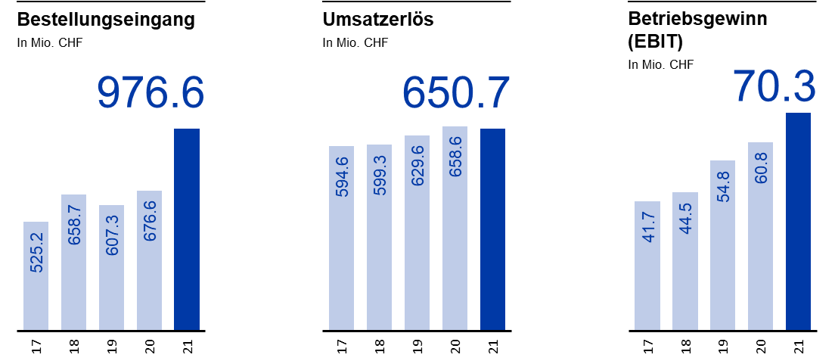
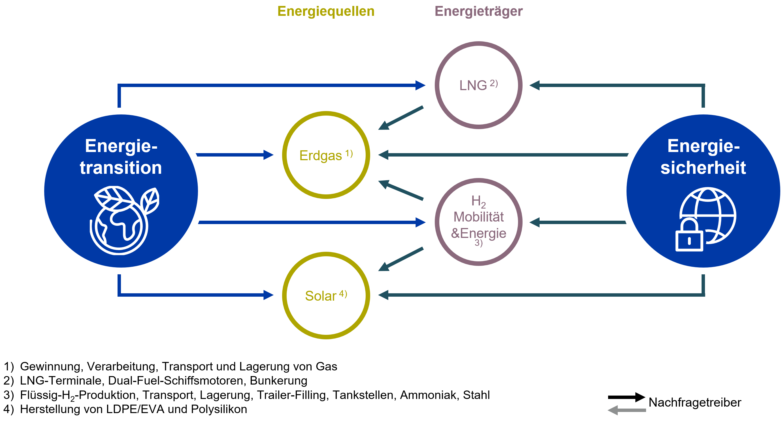
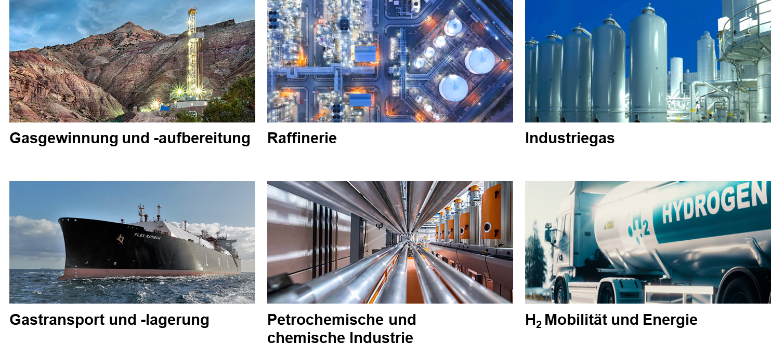
Burckhardt Compression
FY2021:

Slide 3







Wieso Wasserstoff?
HYDROGEN
SOURCE
20 %
Rad / Schraube
HYDROGEN
UTILIZATION
Green
(Electrolyser)
30 %
Brennstoffzelle /
Antrieb
3 %
Betankung
40 %
Elektrolyse
7 %
Transport
Wasserstoff kann die Produktion von der Nutzung zeitlich und räumlich entkoppeln
Wir brauchen sehr viel erneuerbaren Strom
Notes:
It is important on the way forward that as a supplier we work closely with our partners and customers when developing the right products for the different application
To produce H2, different energy sources are used and therefore we get from green to gray H2 depending on the resource
Some regions are pushing H2 independent of the energy source just to make H2 popular (South Korea) and some regions such as Europe are already focusing on renewable energy source (green H2)
Green energy however has still a price and is expensive and H2 productions needs a lot of energy and I am personally not sure if we can only do it with green energy
Availability, production and price of energy will play an important role for the success of H2 → to use the different energy sources is a must to push the H2 market

Slide 4
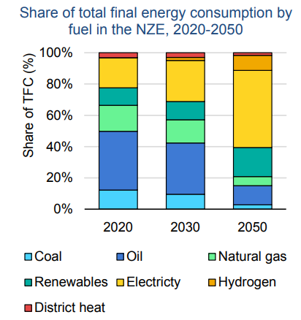
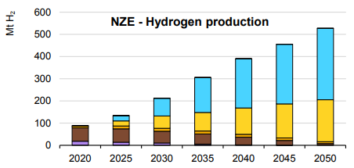
Wasserstoff – International Energy Agency (Report 2021) 1/2
Installierte Elektrolyse-Leistung muss von 0.3 GW (2021) auf 3’600 GW (2050) erhöht werden.

Slide 5
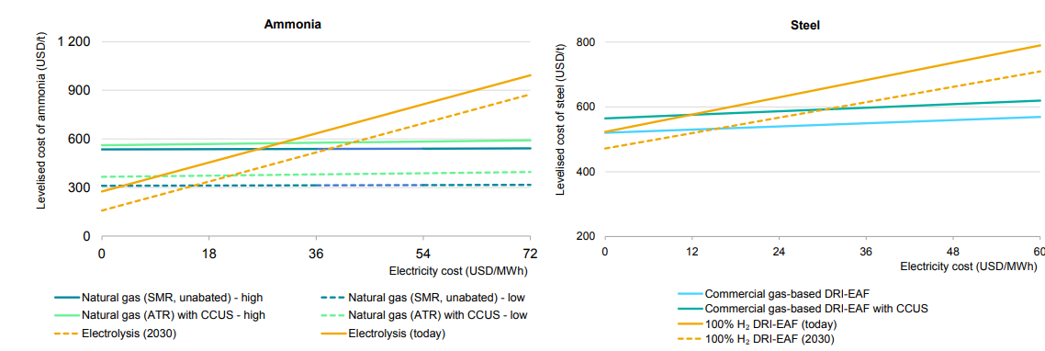
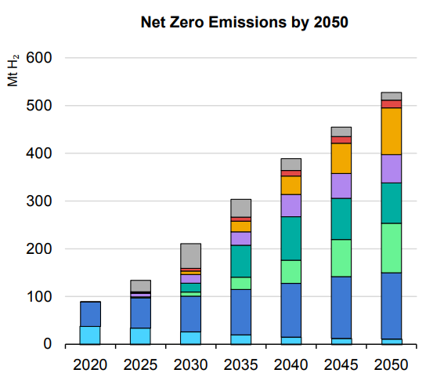
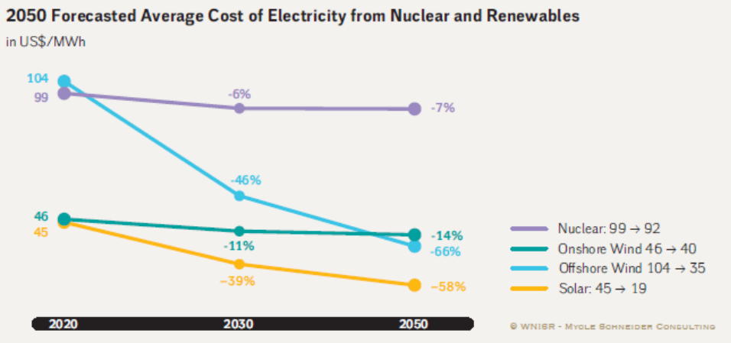
Wasserstoff – International Energy Agency (Report 2021) 2/2
Hydrogen Demand by Sector
→ Riesige Infrastruktur Herausforderung
Notes:
Notes: SMR = steam methane reforming. ATR = autothermal reforming. DRI-EAF = direct reduced iron - electric arc furnace. CCUS = carbon capture, utilisation and storage
→ Link to smart machines

Slide 6
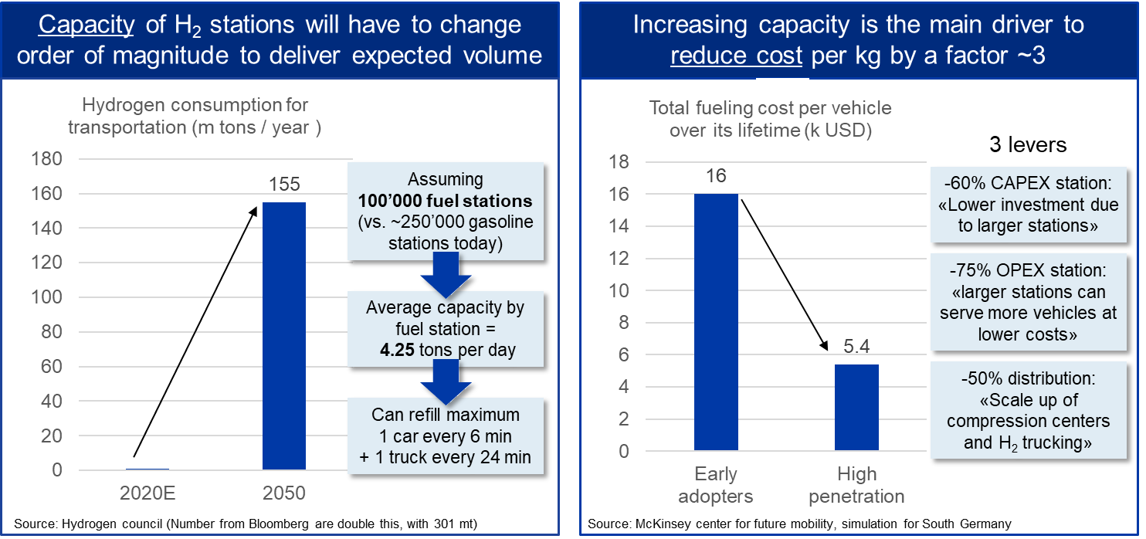
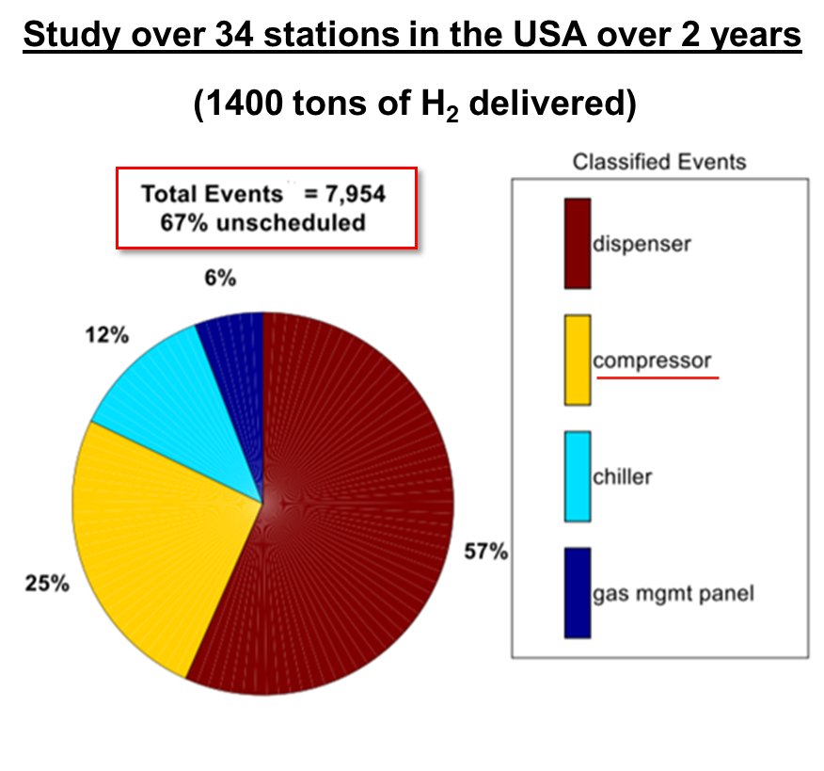
Infrastruktur: Betankungs-Infrastruktur muss günstiger werden, in der Anschaffung als auch im Betrieb
Das entspricht einer ungeplanten Abschaltung wegen des Kompressors pro Tonne H2 die betankt wurde
Ziel:
Reduktion der Wartungs-Interventionen auf eine pro ca. 8’000 Betriebsstunden, Also einen pro ca. 1’400 Tonnen H2 betankung

Slide 7
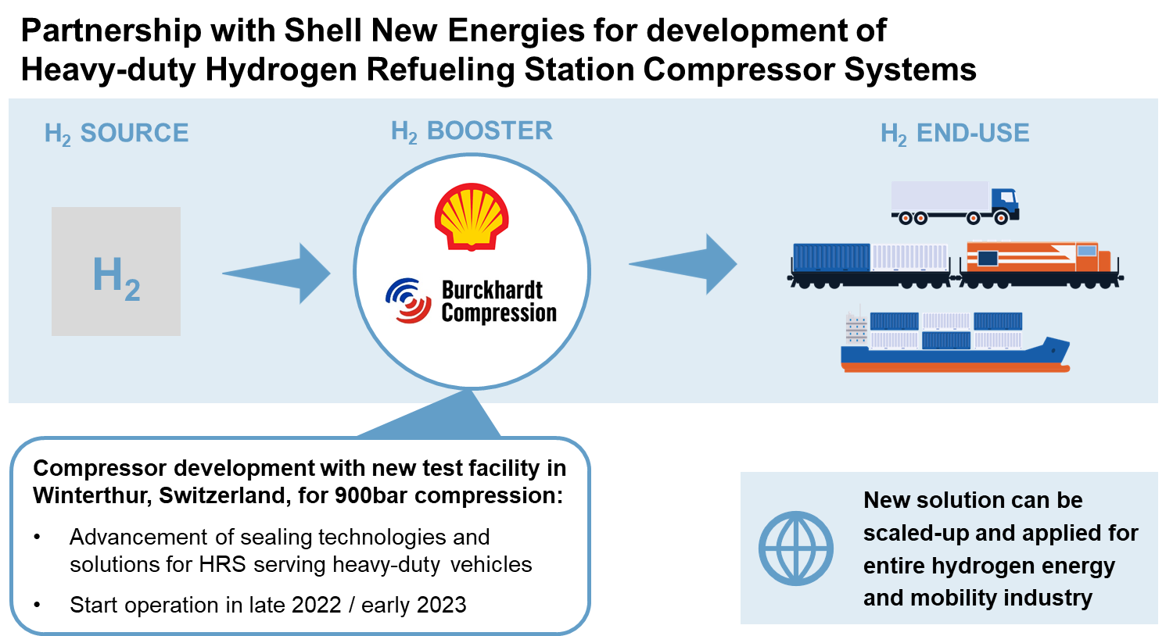

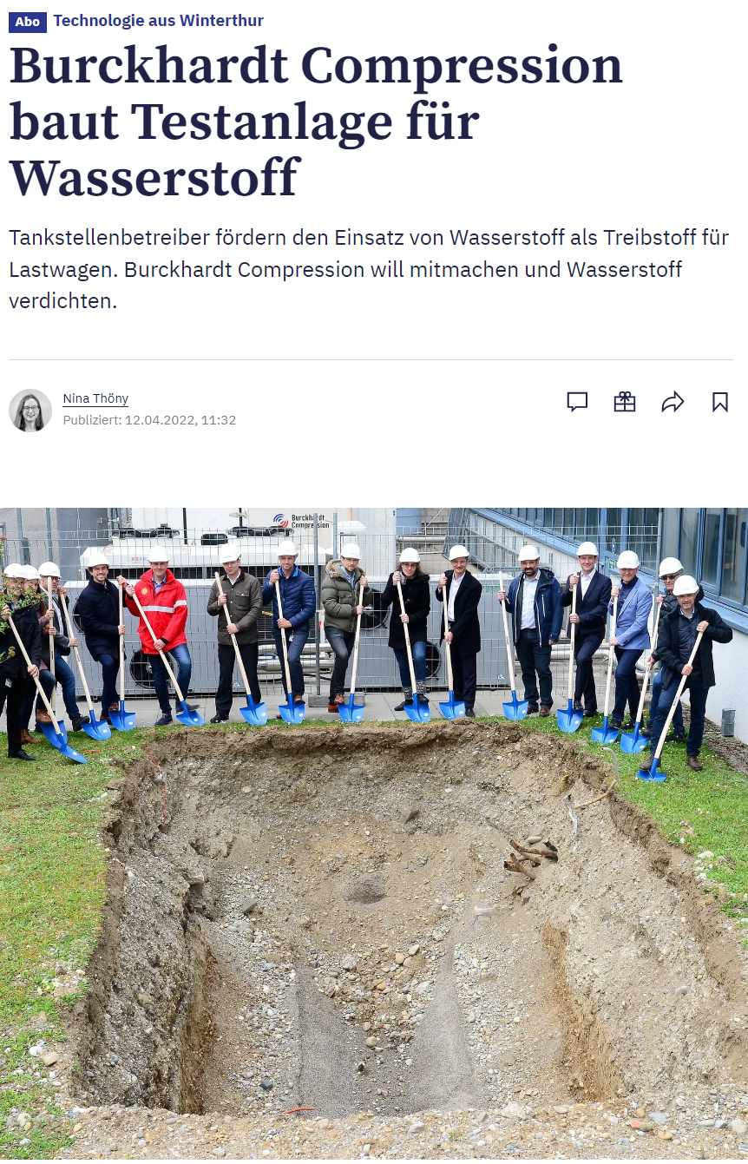
Innovation – Pushing the Limits of High-Pressure Hydrogen Compression

